Slide 1


Social Buzz Data Analysis

Slide 2


Today's agenda
Project recap
Problem
The Analytics team
Process
Insights
Summary

Slide 3

Social Buzz is a fast growing technology unicorn that need to adapt quickly to it’s global scale.
Accenture has begun a 3 month POC focusing on these tasks:
An audit of Social Buzz’s big data practice.
Recommendations for a successful IPO
Analysis to find Social Buzz’s top 5 most popular categories of content.
Project Recap

Slide 4

Problem
Over 100000 posts per day
36,500,000 pieces of content per year!
But how to capitalize on it when there is so much?
Analysis to find Social Buzz’s top 5 most popular categories of content

Slide 5



Nathan Cummings
Chief Technical Architect
The Analytics team
Matt Donovan
Senior Principle
Padmaja
Data Analyst

Slide 6
Process
1
Data Understanding
2
Data Cleaning
3
Data Modelling
4
Data Analysis
5
Uncover Insights

Slide 7

Insights
16
1897
January
Unique Categories
Reactions to Animal Posts
Month with most posts

Slide 8
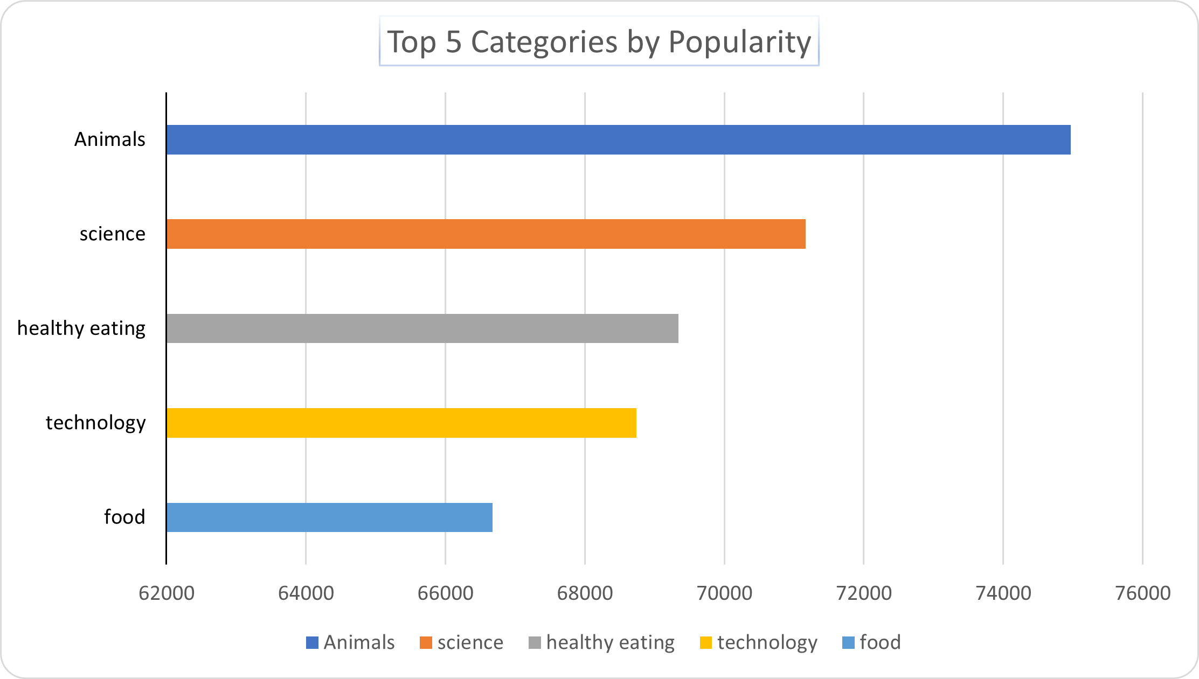

Slide 9
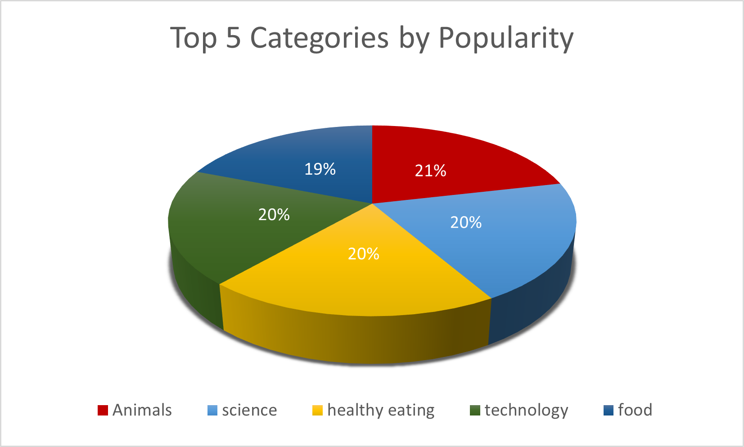

Slide 10

Analysis
Animals and science are the two most popular categories of content, showing that people enjoy “real-life” and “factual” content the most.
Insight
Food is a common theme with the top 5 Categories with “Healthy Eating” ranking the highest. This may indicate the audience type within your user base. With this insight, you can create a campaign and work with healthy eating brands to boost user engagement.
Next Steps
This analysis is insightful, but it’s time to take this analysis into larger scale production for real-time understanding of your business. We can show you ow to do this.
Summary

Slide 11
Thank you!
ANY QUESTIONS?

